Slide 1
WPI Mathematics Institute for Secondary Teaching
Prof. Luca Capogna, Department Head
MIST
July 17, 2017

Slide 2
The Goals of MIST
MIST is a collaborative workshop where high school math teachers, college math faculty and professional mathematicians working in industry engage in a series of conversations and projects to gain a better understanding about how high school mathematics has a pivot role in the job market today, and how it provides the foundation for college level mathematics.

Slide 3
The Goals of MIST
The schedule includes presentations about applications of mathematics and statistics from a variety of perspectives: Health Services, Computer Games, Data Sciences, Financial industry, Actuarial careers, Manufacturing Technology, Robotics and more.
Some of the speakers will specifically address ideas for how these perspectives may be shared with high school students.

Slide 4
The Goals of MIST
As integral part of the workshop all the participants will be asked to work in teams on specific projects dealing with the translations of ideas from the presentations to actual educational material for high school students.
The last afternoon will be reserved to group presentations for these projects.
We will ask your permission to share these projects with the broader community, envisioning a growing data base of educational material that can impact many schools.

Slide 5
The Goals of MIST
This is the third edition of MIST.
We had one in 2015 and one in 2017, which were funded by WPI Mathematical Sciences, and by a Toyota-RIT program. This year’s MIST is entirely funded by the WPI Mathematical Sciences department
It is a pleasure to acknowledge the work of our assistant operations manager Ms. Rhonda Podell, our IT manager Mike Malone and of the rest of the organizing team of WPI faculty John Goulet, Stephan Sturm, Suzanne Weekes.

Slide 6
What do we talk about when we talk about Mathematics.
What do mathematicians do?
Where do they work?
Is their work impactful? Does it matter?
Is it a competitive, desirable career?

Slide 7
What do Mathematicians Do?
“The universe cannot be read until we have learned the language and become familiar with the characters in which it is written. It is written in mathematical language, and the letters are triangles, circles and other geometrical figures, without which means it is humanly impossible to comprehend a single word. Without these, one is wandering about in a dark labyrinth”
Galileo Galilei (1564-1642)
Through their work, Mathematicians build a language that allows us to experience in a quantitative and self consistent fashion the complexity of nature. The language is used by Physicists, Engineers, Economists,…

Slide 8

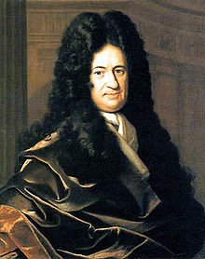
A powerful language: Calculus
Isaac Newton (1643-1727)
Gottfried Wilhelm Leibniz (1646-1716)

Slide 9
Math allows us to experience infinity
Normal numbers are special numbers in which every sequence of digits will sooner or later appear in their decimal representation.
For instance the number
0.12345678910111213….
has this property.
What do they have to do with understanding infinity?

Slide 10

Math allows us to experience infinity
This number 0.12345678910111213…. contains any discrete data imaginable.
For instance … your SSN, all your credit card numbers ….

Slide 11
Math allows us to experience infinity
This screenshot, is represented in the pdf file as a list of 0 and 1 and so it is encoded as a number which is contained in any normal number.
Any image that can be represented in this way is contained in any normal number ….

Slide 12

Math allows us to experience infinity
This number 0.12345678910111213…. contains any possible picture of you as a baby
… as well as all other babies in history

Slide 13
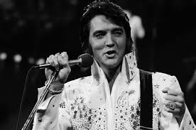
Math allows us to experience infinity
This number 0.12345678910111213…. contains any possible sound, encoded as mp3 file. This means any performance of any song ….
… any piece of music that has ever been written
… Any tune you have ever whistled in the shower …

Slide 14
Math allows us to experience infinity
Mathematicians can prove that ALMOST EVERY NUMBER (in a precise mathematical sense) has this property, but currently we do not have any algorithm to decide whether a given number, for instance π, is normal or not.

Slide 15
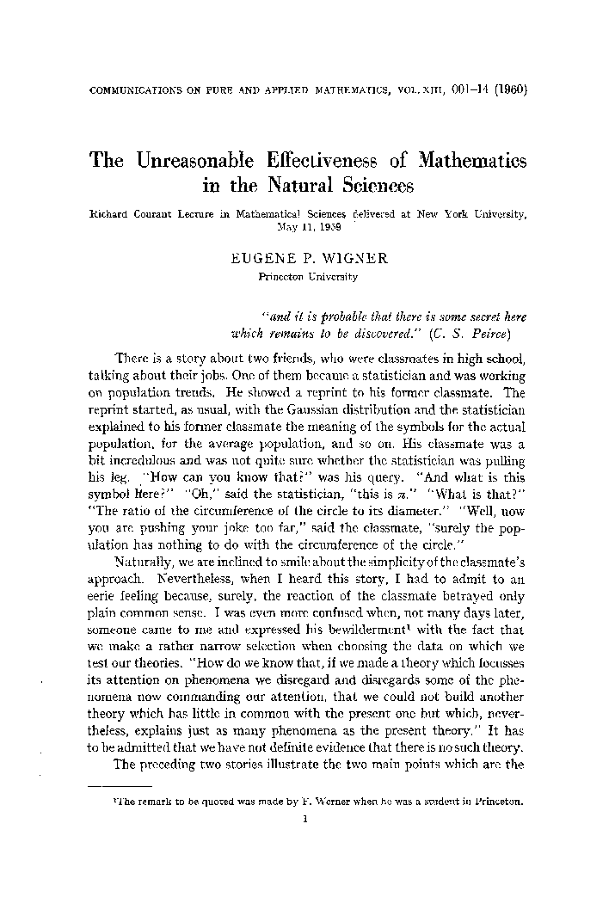
Why study Mathematics?
In 1960 Physics Nobel prize
Eugene Wigner wrote a famous
article in which he observed how
Mathematical Structures used to
model Physical Theories often
(and inexplicably) lead to further
advances in that theory.

Slide 16
Medical imaging and math
At the heart of every medical imaging technology is a sophisticated mathematical model of the measurement process and an algorithm to reconstruct an image from the data.
Key Mathematical instrument is the inverse of the Radon Transform

Slide 17
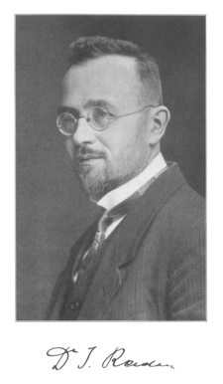
Johann Radon (1887-1956)
Radon Transform introduced
In 1917. A long time before
The technology for medical
Imaging was developed.
This is an example of how
“pure” math becomes
“applied” math over centuries

Slide 18
Why study Mathematics?
Because one is drawn to logical analysis, patterns and structure (you have the “math gene”).
Because it is a powerful and beautiful language that can be used to model and predict systems from biology, physics, engineering, …
Because it opens up a wide range of appealing job opportunities…

Slide 19
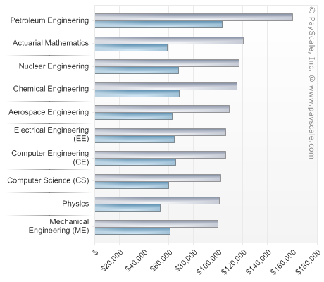
Why study Mathematics?
Competitive
Salaries
Top Ten Majors
by Salary potential.
www.payscale.com 2015-2016
Statistics is #13, and Applied Math is #16

Slide 20
Example: WPI grads
WPI wide employement rate is 91.7%
WPI wide BS grads salary: $66,805
Math Sciences grads: $68,000

Slide 21

Wall Street Journal Article
2014 Ranking of the Best and Worst Jobs
1. MATHEMATICIAN
Applies mathematical theories and formulas to teach or solve problems in a business, educational, or industrial climate.
3. STATISTICIAN
Tabulates, analyzes, and interprets the numeric results of experiments and surveys.
4. ACTUARY
Interprets statistics to determine probabilities of accidents, sickness, death, & property loss from theft & natural disasters.

Slide 22

Where do Mathematicians Work?
Arts, entertainment, and recreation
Education
Finance and insurance
Government
Health care and social assistance
Information technology
Legal services
Management of companies & enterprises
Manufacturing
Nonprofit
Other science and technology
Retail trade
Transportation & warehousing
Utilities
http://www.ams.org/early-careers/

Slide 23
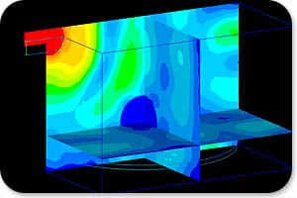
Mathematics and Big Data
Analysis of large sets of data, be they genetic markers (220 millions base pairs) or Netflix preferences (matrix composed of 50 millions rows and about 20,000 columns), is carried out through an intense use of mathematics and statistics. there is a need for mathematicians and statisticians who can develop tools for
modeling,
analysis, and
simulation

Slide 24
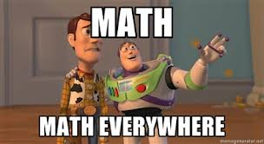
Mathematics in Entertainment
100 powerful supercomputers perform geometrical, algebraic and calculus-based calculations to animate Pixar's characters.

Slide 25
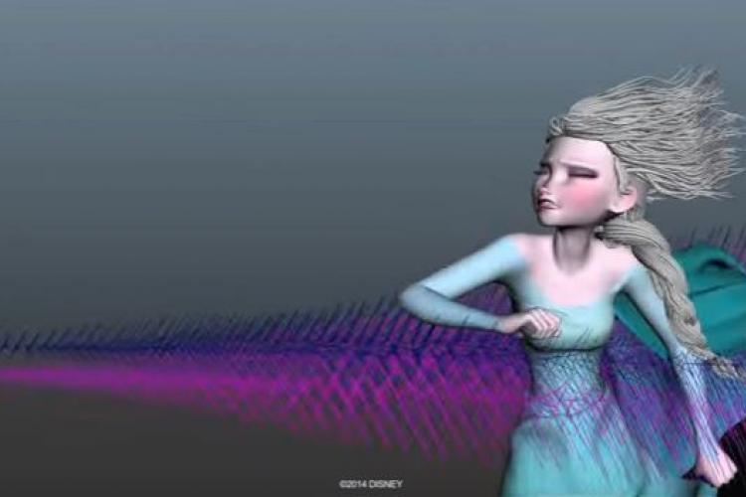
Mathematics in Entertainment
Alex McAdams, a mathematician working at Disney Studios used math modeling and computational physics to do realistic hair simulations in the movies Tangled and Frozen

Slide 26
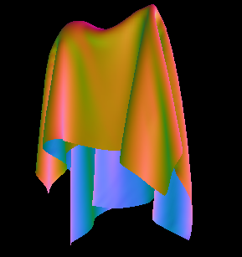
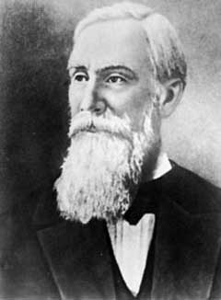
Mathematics in Entertainment
Pafnuty Chebyshev
The laws of physics that describe the dynamics of fabric movement are modeled by mathematicians and used in computer graphics and in animations.

Slide 27
What is Math Used For?
Automobile and aircraft design
Oil recovery
Understanding cardiovascular diseases
Understanding the spread of diseases
Bringing architectural design to reality
Understanding movement of bird flocks
Predicting climate and weather
Figuring out the best way to board an airplane
Manufacturing better eyeglass lenses
Finding the effects of voting procedures on election results
Computer graphics and animation
Internet encryption
Data storage on CDs and DVDs
Designing efficient water purification systems
http://www.ams.org/mathmoments

